Slide 1
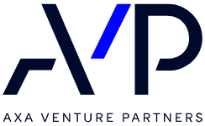
Navigating and benefiting from European public funding

Slide 2
Content
D&Consultants in the public funding ecosystem
The keys to a successful application file to European and national calls for proposals
The direct public funding landscape
Questions / Answers

Slide 3
D&Consultants in the public funding ecosystem
Notes:
Speaker : DCA

Slide 4







Our missions : to impact the future of companies and territories, starting today
Scouting
Financing
Steering
Influencing
Valorizing
+ 50
international benchmarks and prospective studies per year
2.1 billion
euros of aid raised
+ 500
project monitored
+ 120
high level institutional meetings per year
+ 50
Valorization studies and technology transfers per year
Prospective and economic development
Funding strategy
Strategic monitoring and project management
Public affairs strategy
Institutional relations
Influence Communication
(Re)positioning and go-to-market strategy
National public funding
Management and innovation process
Innovation strategy
European public funding
Valroization of scientific and technologic assets
Investment and growth strategy
Management and public funding coordination
Fundraising

Slide 5
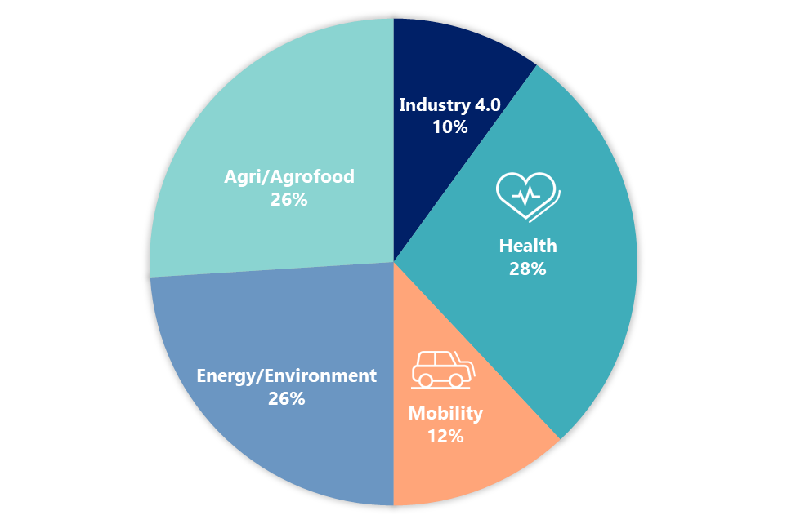
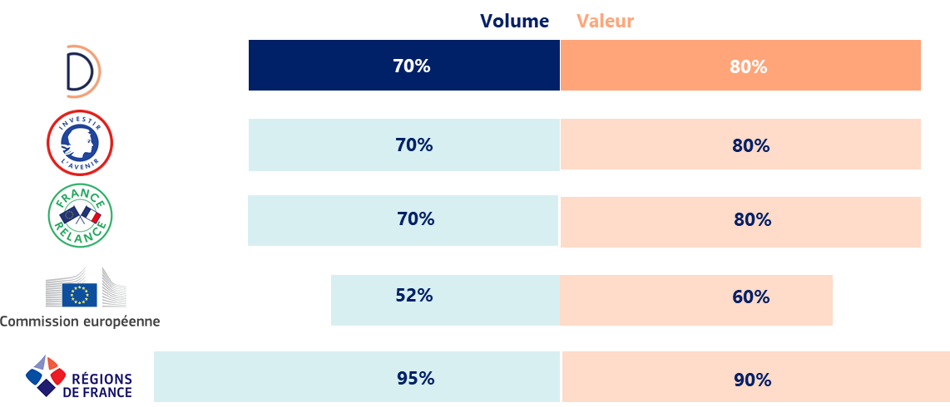

Public funding specialist
+ 2,500 structures have benefited from public funding
thanks to support from D&Consultants
€ 2.1 billion of public funding in various industries
+ Over 800 projects submitted
Success rates twice higher than the average
*Success rates for PIA 3 (2017-2020) and France 2030 (2021-)
Europe: LIFE, H2020, EIC, Horizon Europe, EIB, CEF, Innovation Fund
Regions : Regionalized PIAs, ERDF...
By volume: number of projects financed / number of projects set up
In value: amount of aid obtained / amount of aid requested

Slide 6





















A large network that can be quickly mobilized
Privileged relationships with numerous actors and decision-makers of the innovation ecosystem
Public actors of promotion
Banks and investment funds
Collectivities
Public funders
Professional and sectorial organizations
Competitive clusters
Ministries European DG
Our daily interlocutors

Slide 7
The keys to a successful application file to European and national calls for proposals
Notes:
Speaker : DCA

Slide 8
Lessons from 33 years of supporting innovation and business development in Europe
The 1990s: the challenge of international competitiveness through technological upgrading
The 2000s: the challenge of economic efficiency through analysis of the spin-offs associated with investment in innovation
The 2010s: a sustainable development challenge
The 2020s: sovereignty and security at stake

Slide 9
3 advices to build a strong public funding strategy
1
Look for the right call(s) for proposals according to your R&D and industrial roadmap
2
Anticipate to build consistent projects in regards with public policies and targeted call for proposals specifications
3
Secure public authorities’ payments throughout the project by robust project management and reporting methods
9
Notes:
DCA

Slide 10















1- Looking for the right call(s) for proposals according to your R&D and industrial roadmap
Ask yourself the right questions to target the right financing
At your company
Within the different programs, and under the responsibilities of the operators, calls for proposals are launched by various public and institutional bodies
→ One of these calls for proposals could concern you!
Level of equity?
Status and nationality of supporting company?
For a specific project
Project theme and objectives?
Location?
Carrying arrangements
Project maturity level (TRL)?
Project duration? Start date?
Types of expenses?
Budget? Business plan?
Single partner
Collaborative (partners?)
You need to ask yourself the right questions in order to target the right call for your project.
R&D
Industrial investments

Slide 11
2- Anticipate to build consistent projects in regards with public policies and targeted call for proposals specifications
Optimize your chances of selection
Before applying
During the application
A structured project
Formalization of a first pre-project
Exchanges with the operator
Validation of project compliance and its adequacy with the call
Complementary consortium
Precise role, legitimacy and added value of each partner’s expertise and complementarity
A strong and complete proposal
Relevant and no-frills argumentation, highlighting of key points and coherence of all information
An early application
Start your application several weeks/months before the call for proposal deadline (~6 to 8 weeks for individual projects, and ~4-5 months for European collaborative projects)
Respect of the call for proposal specifications and deadline
Maximum adequacy between the project and the call and explanation of the elements of the call not taken into account

Slide 12




2- Anticipate to build consistent projects in regards with public policies and targeted call for proposals specifications
Promoting your project
Innovative and strategic
A well-argued innovation (state of the art, benchmark), responding to well-identified challenges not yet met
Each partner's added value, specific expertise and expected return on investment defined at the end of the project.
Proximity to other links in the sector (suppliers, end-users, etc.), contributing to the regional and national structuring of the industry
Collaborative nature
Roadmap
A structured, credible roadmap associated to appropriate and consistent resources (HR, Budget)
Risks anticipated through risk analysis
Economic: targeting, segmenting and prioritizing target markets (estimated sales over 5 to 10 years post-project)
Social: estimate the creation of permanent jobs during and after the project and demonstrate the complementarity of skills.
Environmental: qualify and quantify the environmental impact of your project
Impacts

Slide 13
3 - Secure public authorities’ payments throughout the project by robust project management and reporting methods
Anticipate, follow and size the risks of the project
Project-related
External to the projet
Project structuration
Technical
HR
Legal
Operational delays
Regulatory
Ensure the project traceability and deploy robust project management and reporting methods
Follow the project-related time by the teams et define measurable KPI for the project
Store relevant supporting documents (invoices, expenses, etc.)
Deploy efficient cost-accounting methods
Follow up the grants (received, used, paid back)

Slide 14
The direct public funding landscape
Non-dilutive public funding granted to finance company growth, R&D projects and industrial investments
Notes:
Speaker: VMA

Slide 15

Direct public funding
What are the benefits?
From R&I to market
Co-financing of RDI tasks for the development of new industrial and marketable products / services / processes
Non-dilutive
Assistance in the form of grants, refundable advances, subsidized loans, etc.
Leverage effect
Accelerate the timetable and increase the scope and ambition of projects
Label
Communication potential and leverage effect on other funding sources
Optimizing funding for collaborative R&I
The possibility of financing R&D partners, thus limiting subcontracting costs
Risk sharing
Support of technological, regulatory and market risks, etc.

Slide 16












Major public programs to meet complementary challenges
Horizon Europe - €95 billion
European Union's new 2021-2027 framework program for research and innovation, to strengthen the EU's scientific and technological foundations, boost competitiveness and industry, and help address global issues, including sustainable development challenges
Pillar 1: Excellent Science €25 billion For basic research projects
Pillar 2: Global Challenges and European Industrial Competitiveness €54 billion For collaborative work and research linked to societal issues in pre-identified sectors: food, bioeconomy, agriculture, environment, etc.
Pillar 3: Innovative Europe €3.3 billion Support for innovation at national and local levels (EIC Accelerator, EIC Pathfinder, etc.).
Cross-cutting pillar: Widening participation and strengthening the European Research Area €14.4 billion To support activities that will help attract talent, promote its circulation and prevent brain drain
France 2030 - €54 billion
Enable France to regain its environmental, industrial, technological, health and cultural independence.
Be one step ahead in these strategic sectors - 5-year program
Better living: investing in healthy, sustainable and traceable food, producing 20 biomedicines and creating the medical devices of tomorrow, leading the way in the production of cultural and creative content.
Better production: become the leader in green hydrogen, decarbonize industry, produce 2M electric and hybrid vehicles, produce 1st low-carbon aircraft
A better understanding of the world: taking part in the new space adventure, investing in the seabed field

Slide 17




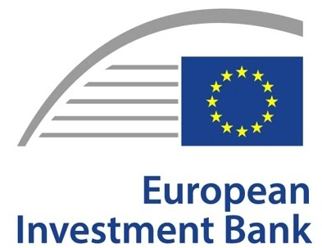

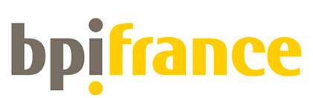









Direct public funding - How is it organized?
1 - Public Authorities
→ Vote on and approve major structuring programs
Regional Councils
of which PIA 4 - Programme Investissement Avenir
Regional council appropriations
France 2030
Horizon Europe
2- Various funding operators
→ Propose and operate calls for proposals within the framework of these programs
i-lab
i-nov
i-Demo
ADI
Loans
FEDER
FEADER
AAP Horizon Eu
EIC
LIFE

Slide 18

Focus on European funding
Information
Horizon Europe program
EUR 95.5 billion for the 2021 – 2027 period
New calls for projects open regularly each year and defined in the Work Programs
2025-2026 Work Programs to be published by the end of the year to define the stratgic priorities and the calls for proposals deadlines
Horizon Europe program for R&I
  Calls for proposals for European collaborative projects within the framework of Pillar 2 thematic clusters
  EIC Pathfinder, Transition and Accelerator calls to develop and deploy breaktrhough innovation to the market
Eurostars for European SMEs collaborations
Innovation Fund to support industrial decarbonization investments projects
LIFE environment and climate program
European Interconnection Facility (CEF)
European Investment Bank (EIB)

Slide 19


THANK YOU!
Feel free to contact us, for any question or to launch a diagnosis
Dominique Carlac'h
President
Vincent Martin
Partner
vmartin@DetConsultants.com
06 08 08 27 94

